Slide 1
C# Roslyn and You
https://www.slideshare.net/jimwooley/improving-code-quality-with-roslyn-analyzers
https://github.com/jwooley/Analyzers
https://github.com/jwooley/RoslynLabs

Slide 2




About Jim
Solultion Architect
Microsoft MVP
Slalom Consulting
Visual Studio Tools
03
Author
@JimWooley
LINQ in Action
https://jwooley.github.io
https://github.com/jwooley/Analyzers
http://www.thinqlinq.com
Notes:
Click the icon and navigate to your photo on your computer
Crop and position photo as desired
Go to the Arrange drop down menu > choose “send to back” to reveal text

Slide 3
Agenda
C# past present and future
C# Scripting
Static Analysis and Code Styles
Syntax Generators
Hack

Slide 4
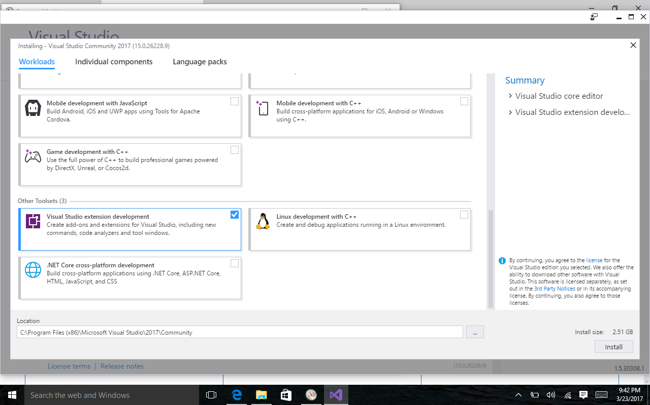
Prerequisite
https://visualstudio.microsoft.com/downloads/
Individual Components:
.NET Compiler Platform SDK
DGML Editor

Slide 5
C# History (before Roslyn)
2002
2005
2008
2010
2012
2013
2015
C# 1/VB7
C# 2: Generics, Iterators, Anonymous Delegates, Nullable, Partial, co/contravariance
C# 3: LINQ, Lambda, Anonymous, AutoProp, Extension Methods, Expression
C# 4: Parallel, Dynamic, optional params, named arguments, embedded interop
C# 5: Async, Caller info
Roslyn
???

Slide 6
Roslyn Language Enhancements
Await in Catch/ Finally
Null propagation
#pragma
Getter only auto property
Dictionary Initializer
Nameof operator
Partial Modules
Exception Filters
Partial Interface
Auto property initializer
#Region inside methods
Using Static
String interpolation
Parameterless struct ctor
Line continuation comments
Multiline string literals

Slide 7
C# Post Roslyn
2015
12/2016
2017
2017
C# 6: Static imports, prop initializers, null propagator, string interpolation, nameof
C# 7.0: Out variables, tuples, pattern matching, local functions, ref locals and returns
C# 7.1: Async main, default literal, inferred tuple names, reference assembly gen
C# 7.2: ref semantics with value types, non-trailing named args, numeric literals, private protected
2018
C# 7.3: tuple equality, constraints, expression variables, custom fixed, ref reassignment
2019
C# 8.0: Default interface, nullable reference types, async streams, generic attributes, ranges
https://docs.microsoft.com/en-us/dotnet/csharp/whats-new/
https://github.com/dotnet/roslyn/blob/master/docs/Language%20Feature%20Status.md

Slide 8
C# Post Roslyn
2020 C# 9
Top Level Statements
Extending Partial
Code Generators
Lambda discards
Static lambdas
Module Initializers
Target Type New
Records
Skip locals init
Native ints
Attributes on local functions
Function pointers
Pattern matching improvements
Target type conditional
Covariant returns
Extension GetEnumerator
https://docs.microsoft.com/en-us/dotnet/csharp/whats-new/

Slide 9
C# Post Roslyn
2021 C# 10
Record structs
File-scoped namespace declaration
Extended property patterns
Constant interpolated strings
Record types seal ToString
Deconstruction assignment and declaration
AsyncMethodBuilder attribute on methods
Global Using directives
https://docs.microsoft.com/en-us/dotnet/csharp/whats-new/csharp-10

Slide 10
C# Language Features
https://github.com/dotnet/roslyn/blob/main/docs/Language%20Feature%20Status.md

Slide 11
C# Scripting
https://github.com/dotnet/roslyn/blob/main/docs/wiki/Scripting-API-Samples.md

Slide 12
Code Quality
Compile
Unit Test
Static Analysis
Peer Reviews
Trend Analysis
CI/CD
Style Guide

Slide 13
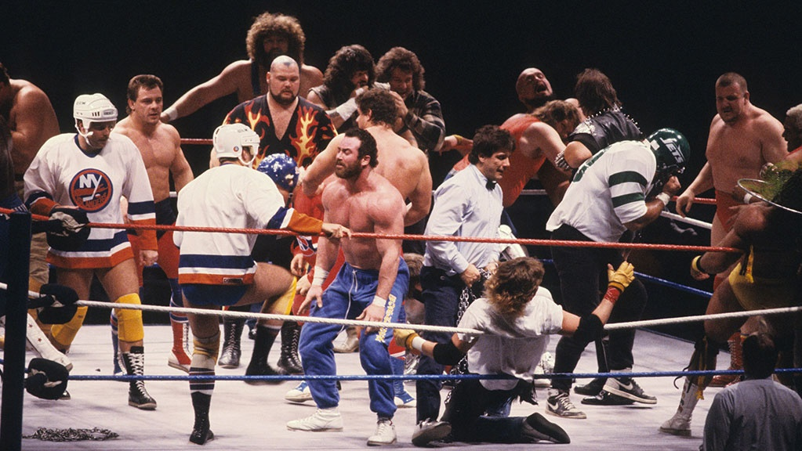

Slide 14

Interchangable team members

Slide 15


Slide 16
Code Quality
Compile
Unit Test
Static Analysis
Peer Reviews
Trend Analysis
CI/CD
Style Guide

Slide 17

“Static program analysis is the analysis of computer software that is performed without actually executing programs.”
Wikipedia
https://en.wikipedia.org/wiki/Static_program_analysis
slalom.com
Notes:
Quote Sample

Slide 18
Why use
Standardize within team
Improve maintainability
Allow code review to focus on domain/logic issues
Detect common errors not caught by compiler
Fix code smells

Slide 19
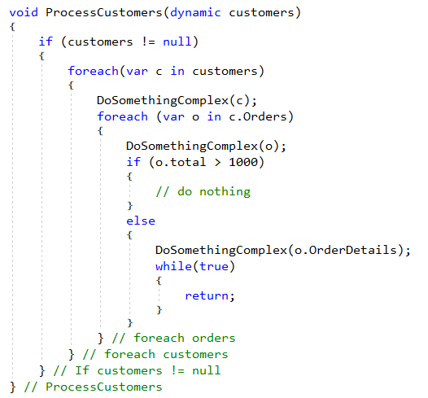
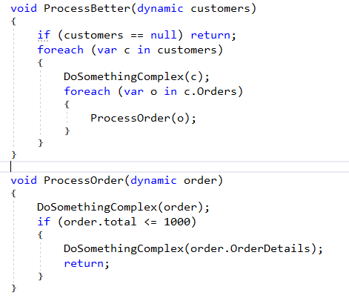
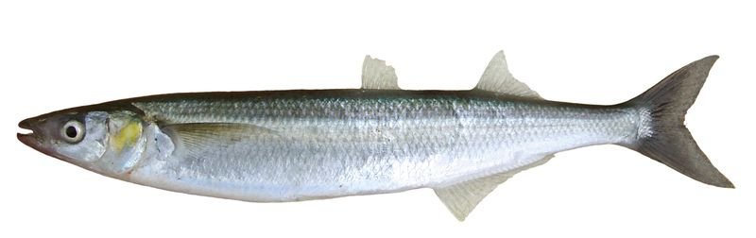
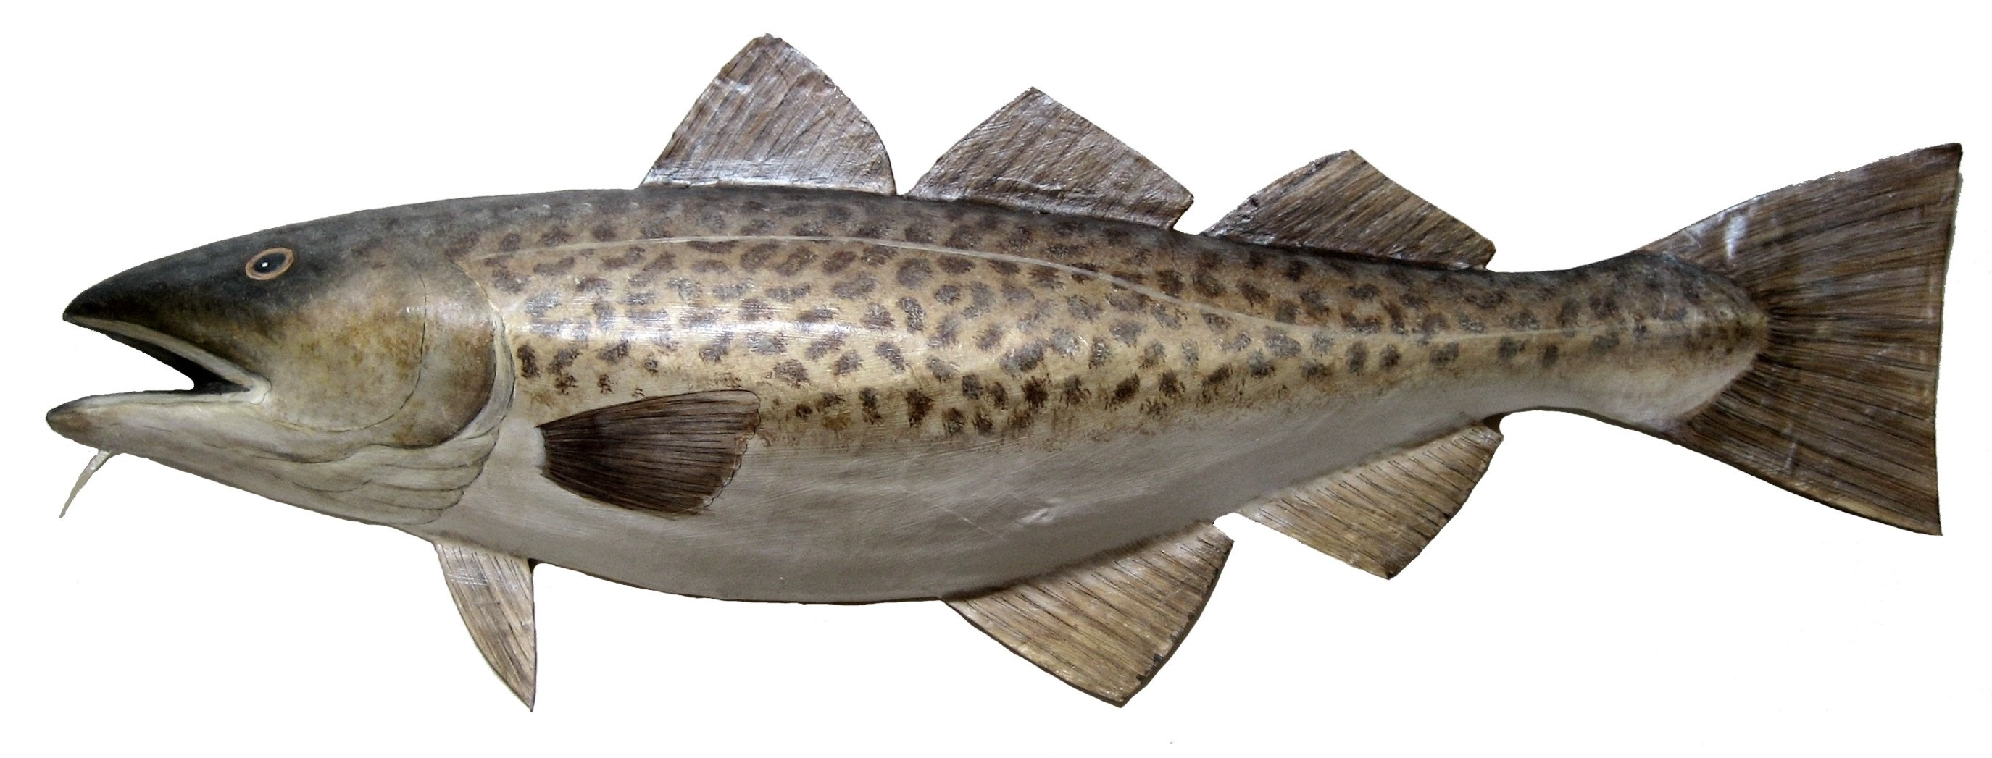

Fixing Cod Smelts
e
^
l

Slide 20
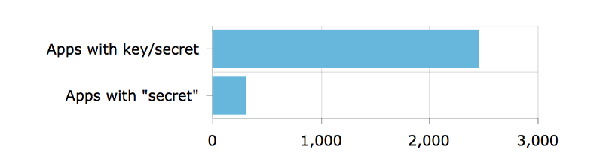
Detect security vulnerabilities
Out of 16,000 apps — apps with keys or secrets
https://hackernoon.com/we-reverse-engineered-16k-apps-heres-what-we-found-51bdf3b456bb#.eechvyizf

Slide 21
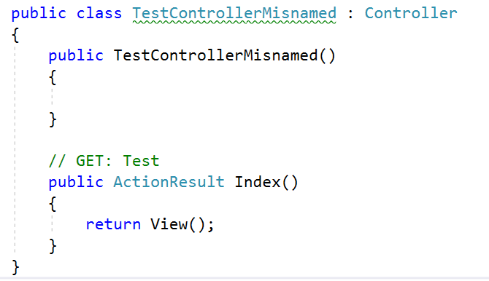
Detect domain specific errors

Slide 22

Recommend best practices

Slide 23
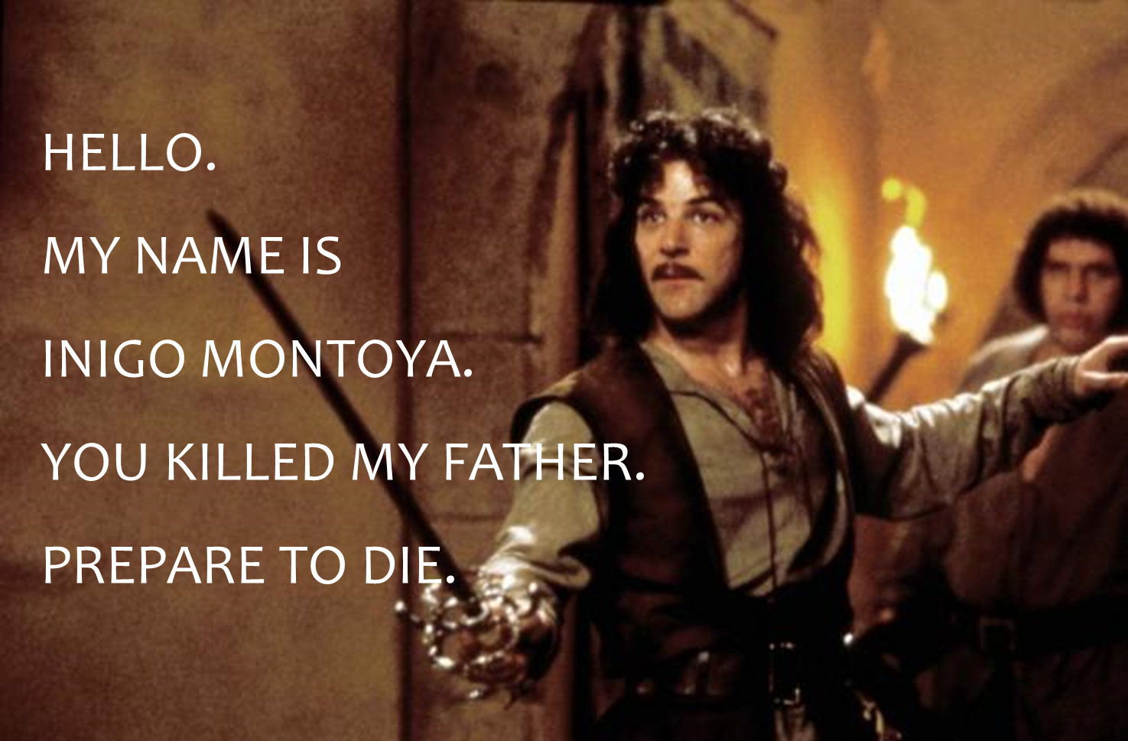
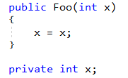
Names matter

Slide 24
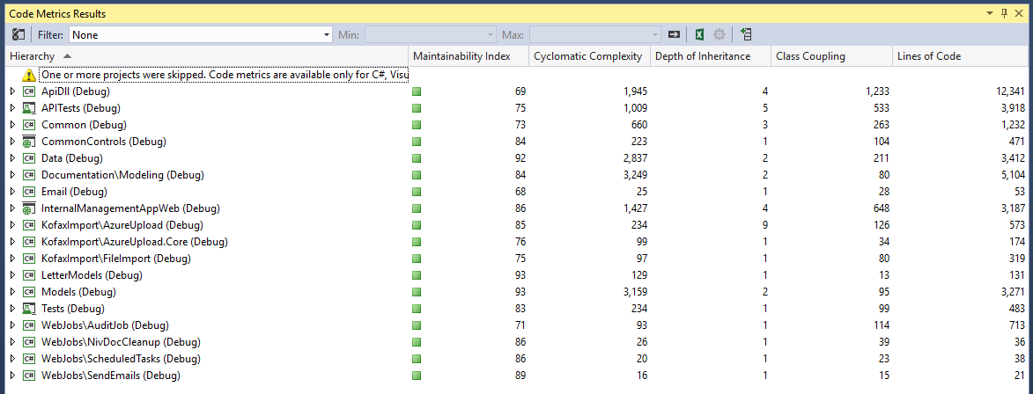
Detect maintainability issues

Slide 25
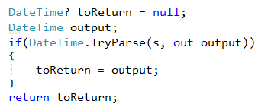
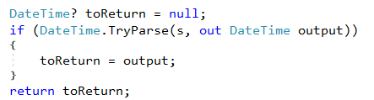
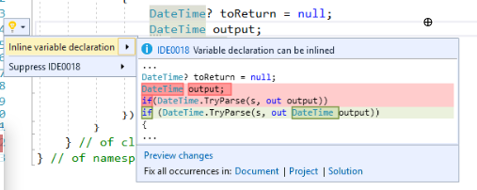
Recommend modernized syntax
Notes:
Click the icon and navigate to your photo on your computer
Crop and position photo as desired
Go to the Arrange drop down menu > choose “send to back” to reveal text

Slide 26
Demo
Using Visual Studio built in analyzers

Slide 27
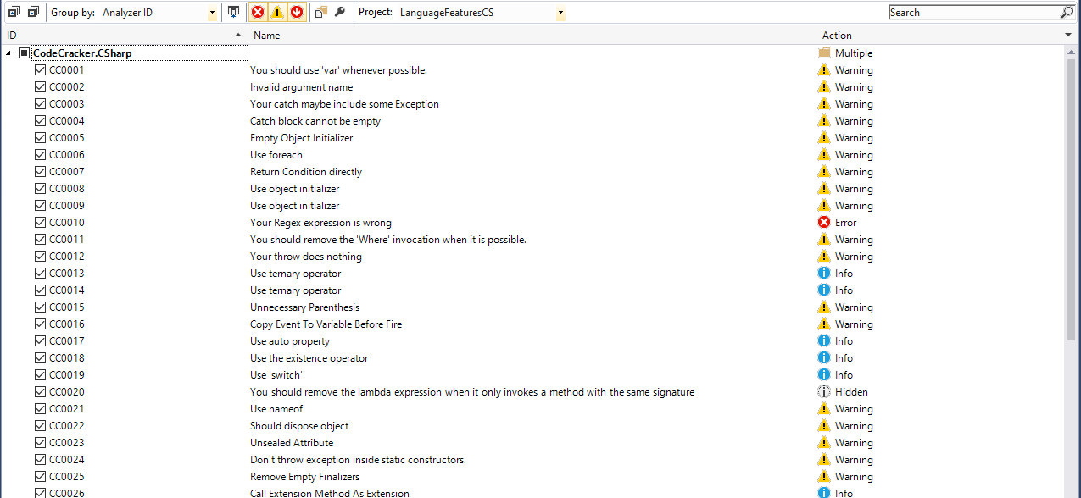
Extensible and Customizable

Slide 28
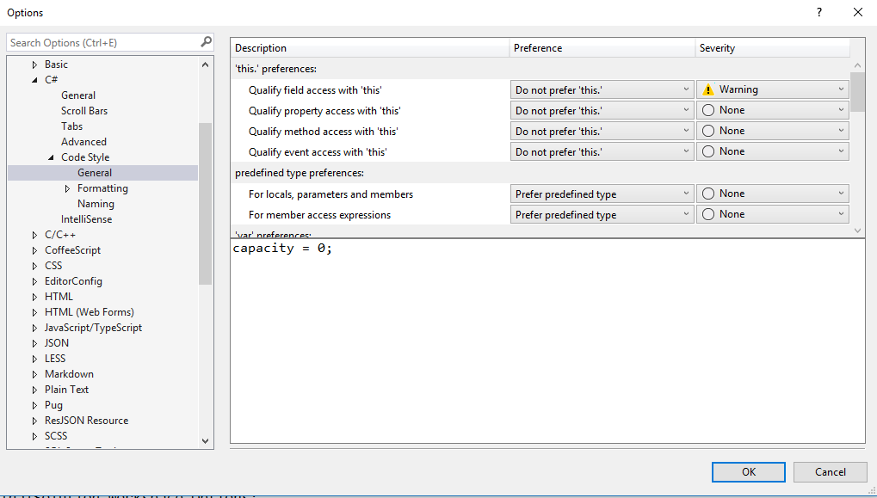
Customizing Code Style

Slide 29
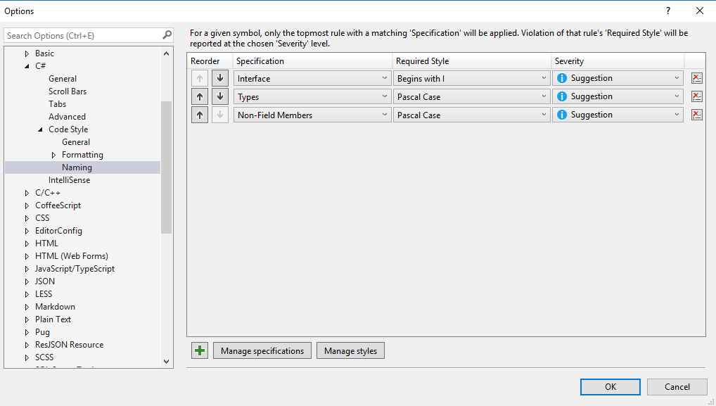
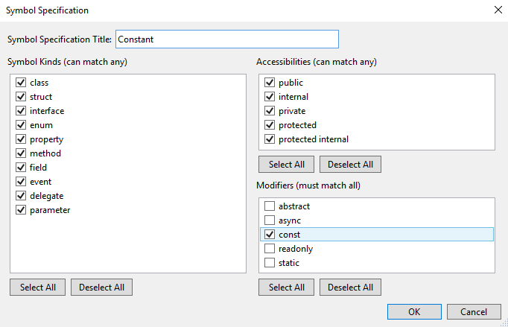
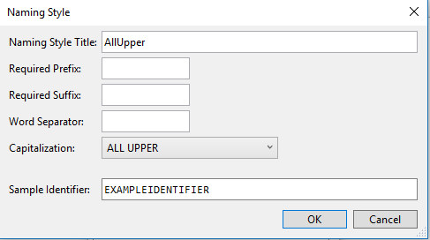
Customizing Naming styles

Slide 30
.editorconfig
[*]
end_of_line = crlf
[*.{cs,py,xmlm}]
indent_style = tab
[*.{js}]
indent_style = space
indent_size = 2
[*.cs]
dotnet_style_qualification_for_field = false:suggestion
dotnet_style_qualification_for_property = false:suggestion
dotnet_style_qualification_for_method = false:suggestion
dotnet_style_qualification_for_event = false:suggestion
dotnet_style_predefined_type_for_locals_parameters_members = true:suggestion
dotnet_style_predefined_type_for_member_access = true:suggestion
dotnet_style_object_initializer = true:suggestion
dotnet_style_collection_initializer = true:suggestion
dotnet_style_explicit_tuple_names = true:suggestion
dotnet_style_coalesce_expression = true:suggestion
dotnet_style_null_propagation = true:suggestion
csharp_style_var_for_built_in_types = true:suggestion
https://docs.microsoft.com/en-us/visualstudio/ide/editorconfig-code-style-settings-reference

Slide 31
Key Principals
Start Early
Run Often
Customize for your needs
Augment SDLC
Focus Code Review on domain issues not code smells

Slide 32
Lab 1 -
Using Visual Studio built in analyzers
https://github.com/jwooley/RoslynLabs
https://docs.microsoft.com/en-us/visualstudio/ide/create-portable-custom-editor-options
https://docs.microsoft.com/en-us/visualstudio/ide/editorconfig-naming-conventions

Slide 33
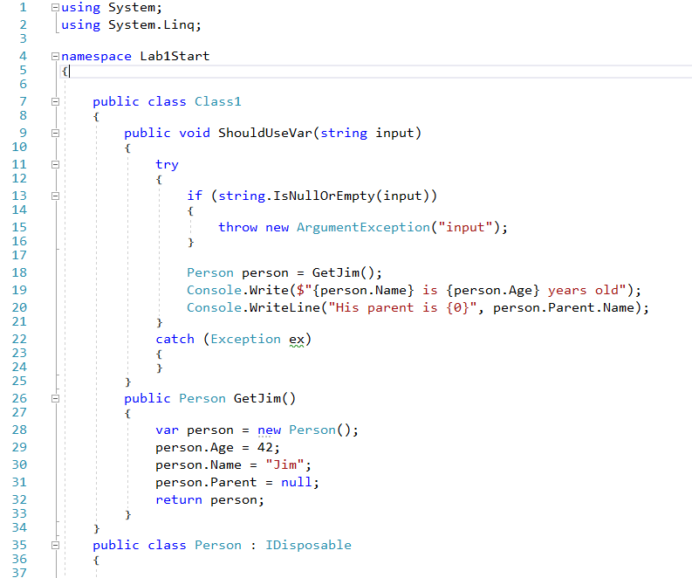
Clean Code?

Slide 34
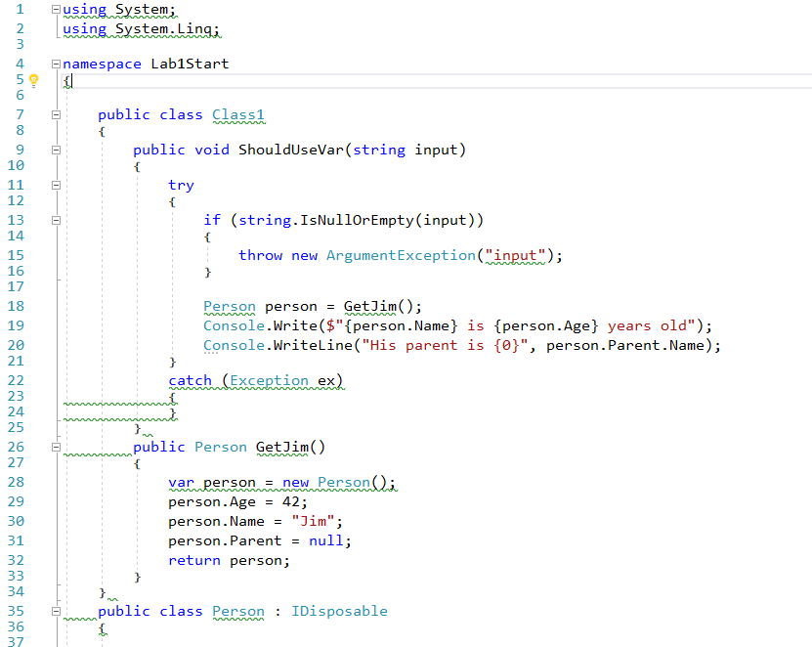
Not so clean

Slide 35
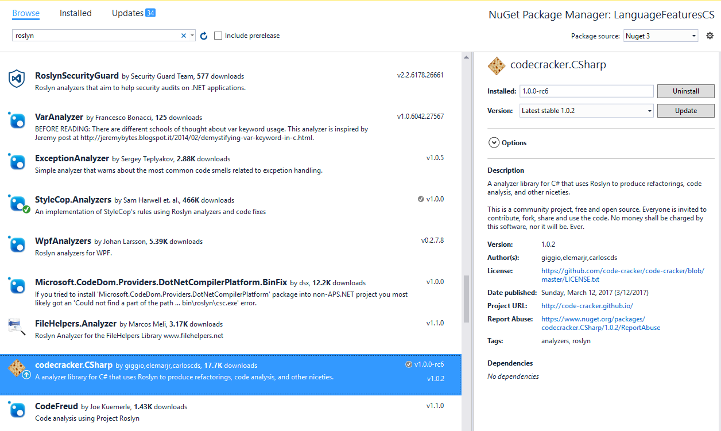
Adding Analyzer from Nuget

Slide 36
Demo
Using third party analyzers

Slide 37
Lab - 2
Using third party analyzers
https://github.com/jwooley/RoslynLabs

Slide 38
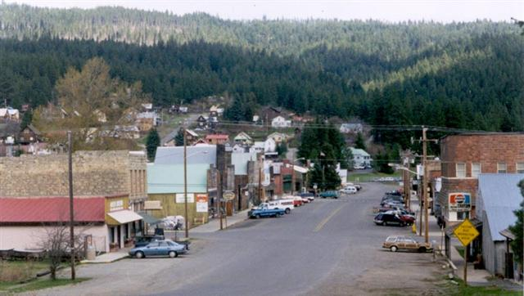
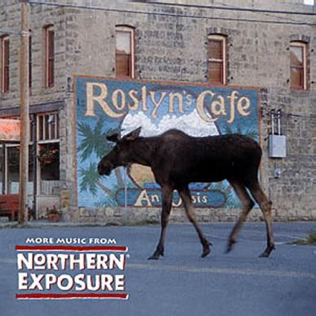
What is Roslyn?

Slide 39
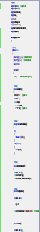
Opening up the compiler
AST
AST
AST
CSC/VBC
IL

Slide 40
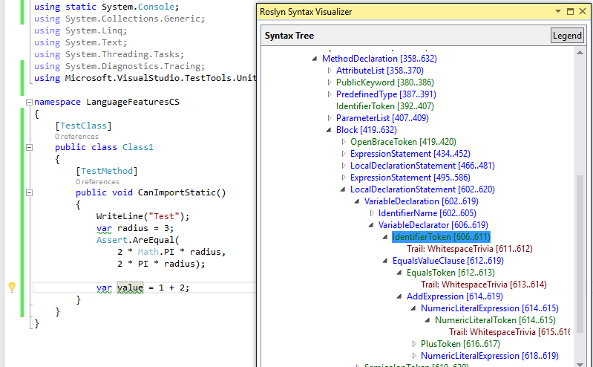
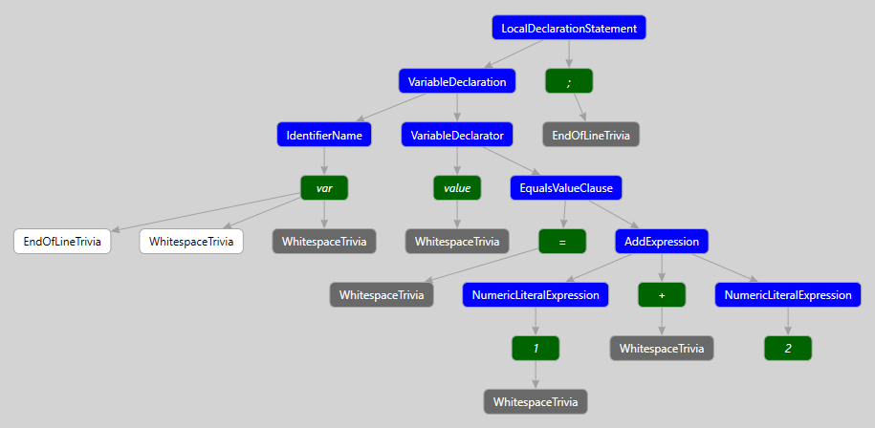
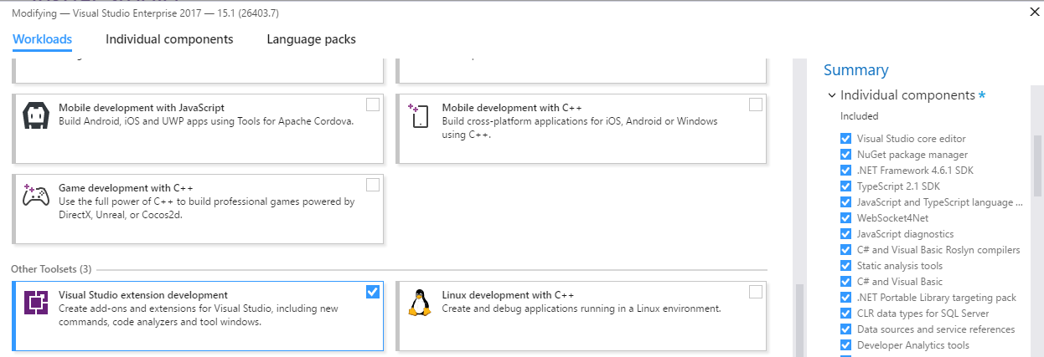
Building your own Fix
ExpressionSyntax
SyntaxToken
SyntaxTrivia
var value = 1 + 2;
var equalsValue =
SyntaxFactory.EqualsValueClause(
SyntaxFactory.BinaryExpression(
SyntaxKind.AddExpression,
SyntaxFactory.LiteralExpression(
SyntaxKind.NumericLiteralExpression, SyntaxFactory.Literal(1)),
SyntaxFactory.LiteralExpression(
SyntaxKind.NumericLiteralExpression,SyntaxFactory.Literal(2))
));
var typeSyntax =
SyntaxFactory.VariableDeclaration(
SyntaxFactory.ParseTypeName("var"),
new SeparatedSyntaxList<VariableDeclaratorSyntax>()
.Add(SyntaxFactory.VariableDeclarator(“value")
.WithInitializer(equalsValue)))
.NormalizeWhitespace(" ")
.WithAdditionalAnnotations(Formatter.Annotation);
var declaration = SyntaxFactory.LocalDeclarationStatement(typeSyntax);
http://roslynquoter.azurewebsites.net/

Slide 41
Detect domain specific errors

Slide 42
Creating your own Roslyn analyzer and Code Fix
[DiagnosticAnalyzer(LanguageNames.CSharp)]
public class WebApiControllerNamingConventionAnalyzer : DiagnosticAnalyzer
{
string DiagnosticId = “WA0001";
string Description = "Controller type should end in 'Controller'";
string MessageFormat = "Type name '{0}' does not end in Controller";
internal const string Category = "Naming";
private static DiagnosticDescriptor Rule = new DiagnosticDescriptor(
DiagnosticId, Description, MessageFormat, Category,
DiagnosticSeverity.Warning, true);
// Add implementation
}
private void Analyzer(SymbolAnalysisContext context)
{
var symbol = (INamedTypeSymbol)context.Symbol;
if (symbol.BaseType == null) return;
if ((symbol.BaseType.Name == "Controller"
|| symbol.BaseType.Name == "ApiController")
&& !symbol.Name.EndsWith("Controller"))
{
var diagnostic = Diagnostic.Create(
Rule, symbol.Locations[0], symbol.Name);
context.ReportDiagnostic(diagnostic);
}
}

Slide 43
Custom Diagnostic - CodeFixProvider
private async Task<Document> MakeEndInControllerAsync(
Document document,
TypeDeclarationSyntax typeDecl,
CancellationToken cancellationToken)
{
var identifierToken = typeDecl.Identifier;
var originalName = identifierToken.Text;
var nameWithoutController = Regex.Replace(
originalName, "controller", String.Empty, RegexOptions.IgnoreCase);
var newName = nameWithoutController + "Controller";
var newIdentifier = SyntaxFactory.Identifier(newName)
.WithAdditionalAnnotations(Formatter.Annotation);
var newDeclaration = typeDecl.ReplaceToken(identifierToken, newIdentifier);
var root = await document.GetSyntaxRootAsync();
var newRoot = root.ReplaceNode(typeDecl, newDeclaration);
var newDocument = document.WithSyntaxRoot(newRoot);
return newDocument;
}
public override async Task ComputeFixesAsync(CodeFixContext context)
{
var root = await context.Document.GetSyntaxRootAsync(
context.CancellationToken).ConfigureAwait(false);
var diagnostic = context.Diagnostics.First();
var diagnosticSpan = diagnostic.Location.SourceSpan;
var declaration = root.FindToken(diagnosticSpan.Start)
.Parent.AncestorsAndSelf()
.OfType<TypeDeclarationSyntax>().First();
context.RegisterFix(
CodeAction.Create("Ensure type ends in 'Controller'",
c => MakeEndInControllerAsync(context.Document, declaration, c)),
diagnostic );
}
[ExportCodeFixProvider("ControllerNameCodeFixProvider", LanguageNames.CSharp)]
public class ControllerNameCodeFixProvider : CodeFixProvider
{
public override ImmutableArray<string> GetFixableDiagnosticIds()
{
return ImmutableArray.Create(DiagnosticId);
}

Slide 44
Lab - 3
Creating your own analyzer and code fix
https://github.com/jwooley/RoslynLabs

Slide 45
Source Generators
Docs https://docs.microsoft.com/en-us/dotnet/csharp/roslyn-sdk/source-generators-overview
Samples: https://github.com/dotnet/roslyn-sdk/tree/main/samples/CSharp/SourceGenerators
Cookbook: https://github.com/dotnet/roslyn/blob/main/docs/features/source-generators.cookbook.md

Slide 46
Roslyn Resources
Github: https://github.com/dotnet/roslyn
Language feature status: https://github.com/dotnet/roslyn/blob/master/docs/Language%20Feature%20Status.md
CSharpLang Proposals: https://github.com/dotnet/csharplang/tree/main/proposals
Dotnet: https://github.com/dotnet
Reference Source: http://source.roslyn.io/
https://github.com/dotnet/roslyn-sdk
http://SharpLab.io
This presentation: https://github.com/jwooley/CSVersions

Slide 47
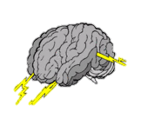
Hack -
Brainstorm Ideas
Creating your own analyzer and code fix
https://github.com/code-cracker/code-cracker
https://github.com/DotNetAnalyzers/StyleCopAnalyzers
https://github.com/JosefPihrt/Roslynator
https://github.com/dotnet/roslyn/wiki/C%23-Interactive-Walkthrough
https://github.com/dotnet/roslyn/blob/main/docs/wiki/Scripting-API-Samples.md

Slide 48
Q & A
Solultion Architect
Microsoft MVP
Slalom Consulting
Visual Studio Tools
03
Author
@JimWooley
LINQ in Action
https://github.com/jwooley/Analyzers
http://www.thinqlinq.com
Notes:
Click the icon and navigate to your photo on your computer
Crop and position photo as desired
Go to the Arrange drop down menu > choose “send to back” to reveal text

